Slide 1
Report on export condition -APAC IMPEX TEAM (Data exclude Taiwan) June 11, 2025

Slide 2
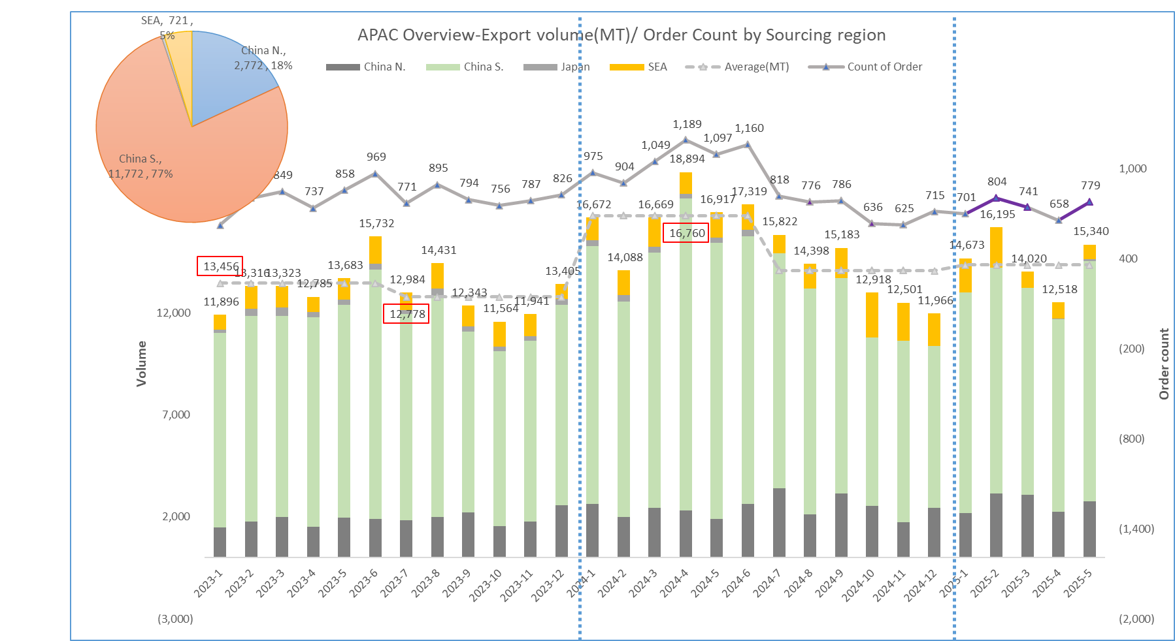
Part 1: 2023-2025 SHIPMENT ORDERS (RELEASED FOR TRANSPORT PLANNING) overview
A. Whole APAC outbound volume-(2024-May VS 2025-May )YoY decrease rate: -9% , MoM increase rate:23%
B. 2025 May:~77% outbound shipments out of South China(main POL: Ningbo, Shanghai)

Slide 3
Part 2: Actual export operation overview of May 2025
A. 77% from South China(Ningbo , Shanghai port); 18% from North China(Tianjin, Qingdao); 5% from SEA.
B. Main business lines for each sourcing region
China N.-HPC, PS
China S.-HPC, Intermediates, PS
SEA-Argo, HPC, N&R

Slide 4
Part 2: May’s orders fulfillment rate-(By product line loading)
Fulfillment rate=( Loaded+ Departed+ Close)/ Total order quantity
APAC: 99% orders were fulfilled in May
China. N: 99%
China. S: 99%
SEA: 99%

Slide 5
Part 2: Tender loading rate (data exclude "F" term orders)
A:
Highlight: tender loading rate peak at 99% from SEA

Slide 6
Part 2: Tender loading rate (data exclude "F" term orders)-Per receiving region
B:

Slide 7
Part 2: Reason for spot

Slide 8
Part 3: Performance from key awarded carrier
MSK still be the key tender allocation source

Slide 9
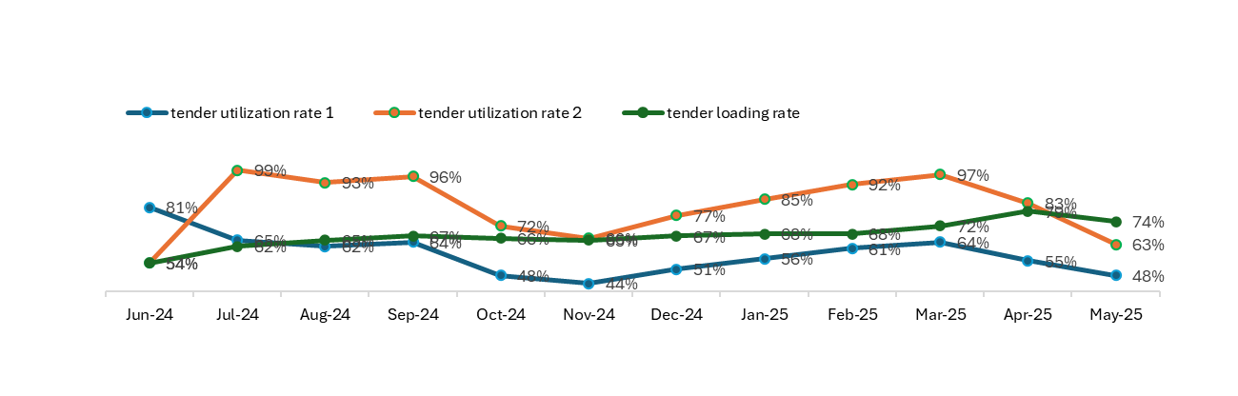
Part 4: Awarded allocation VS Reserved space VS Actual tender loading
Tender utilization rate 1=Actual tender loaded TEU/Awarded allocation
Tender utilization rate 2=Actual tender loaded TEU/Reserved spaces
Tender loading rate=Actual tender loaded TEU/Actual demand

Slide 10
Part 5: Shpt trend and tender loading by biz

Slide 11
Part 5: Shpt trend and tender loading by biz

Slide 12
Thanks

